Slide 1
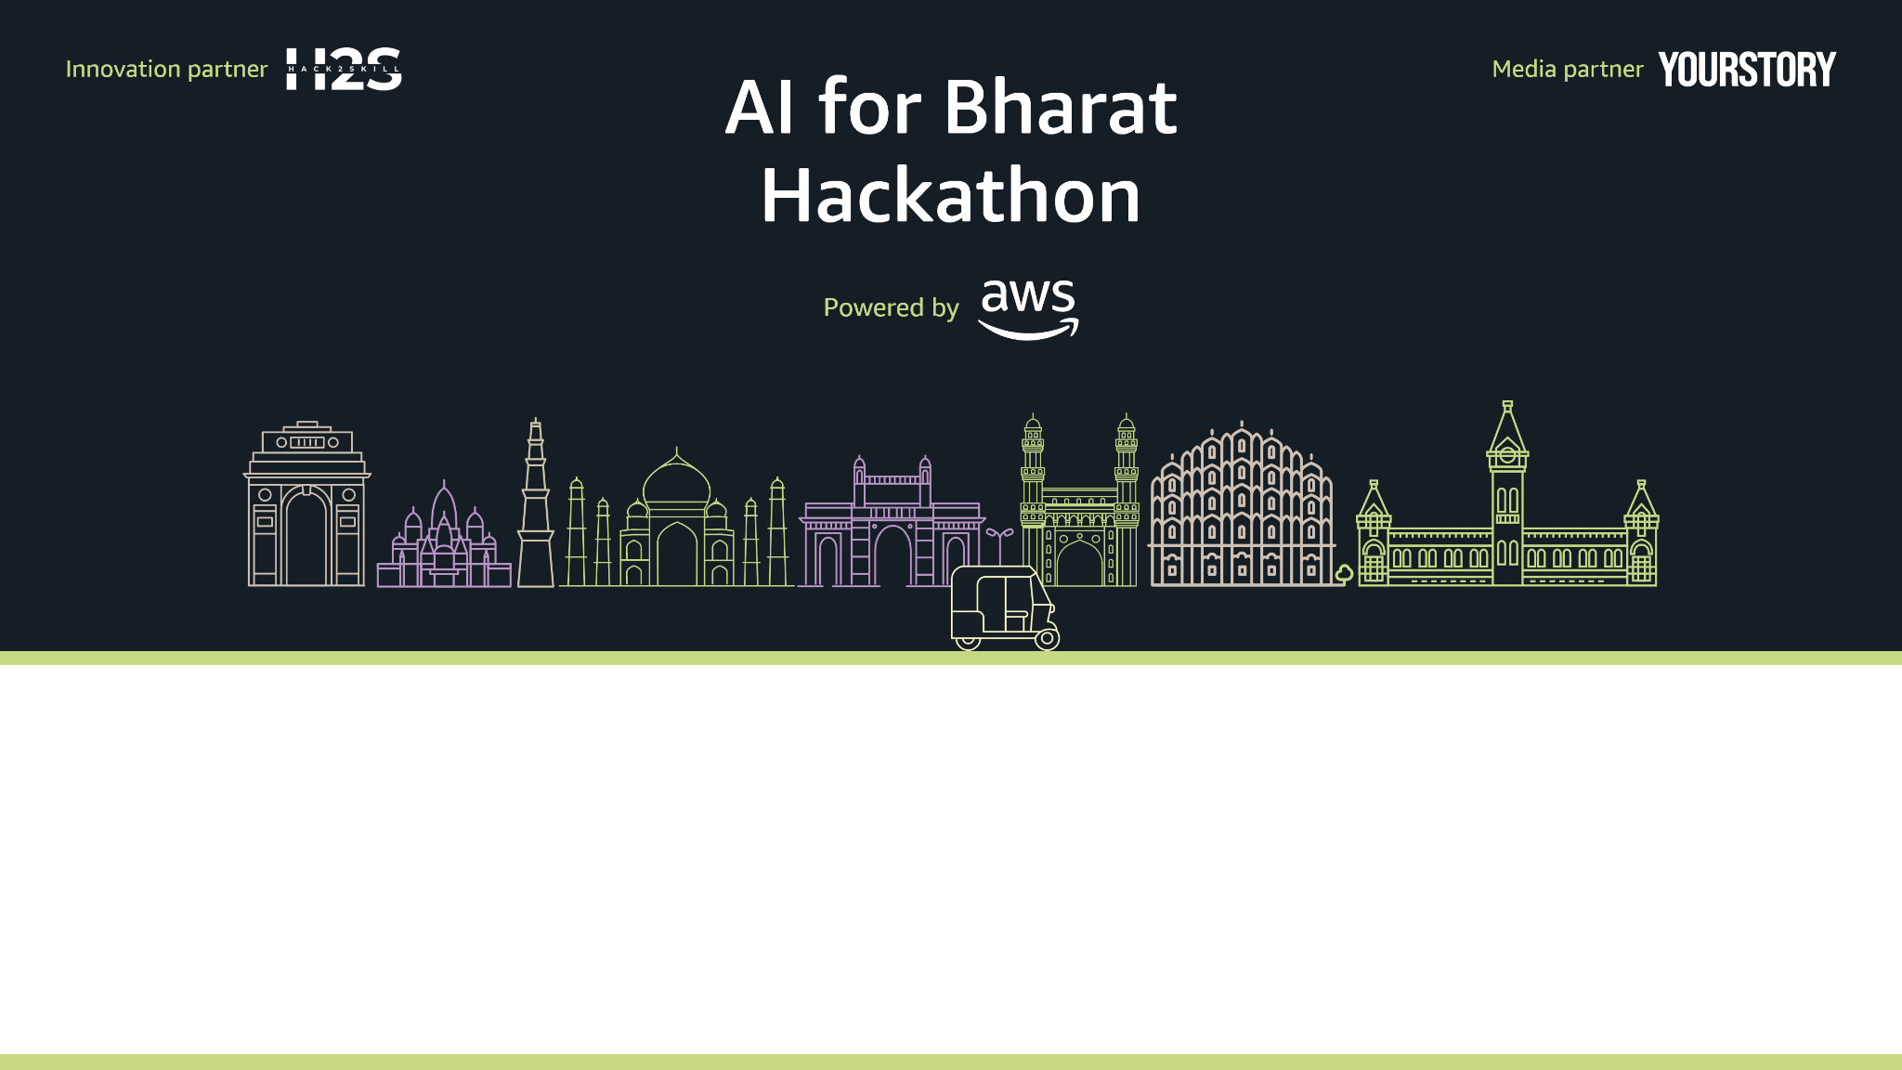
Team Name : VISIONARY_CODERS
Team Leader Name : VAIBHAV SHAW
Problem Statement : AI for Communities, Access & Public Impact

Slide 2
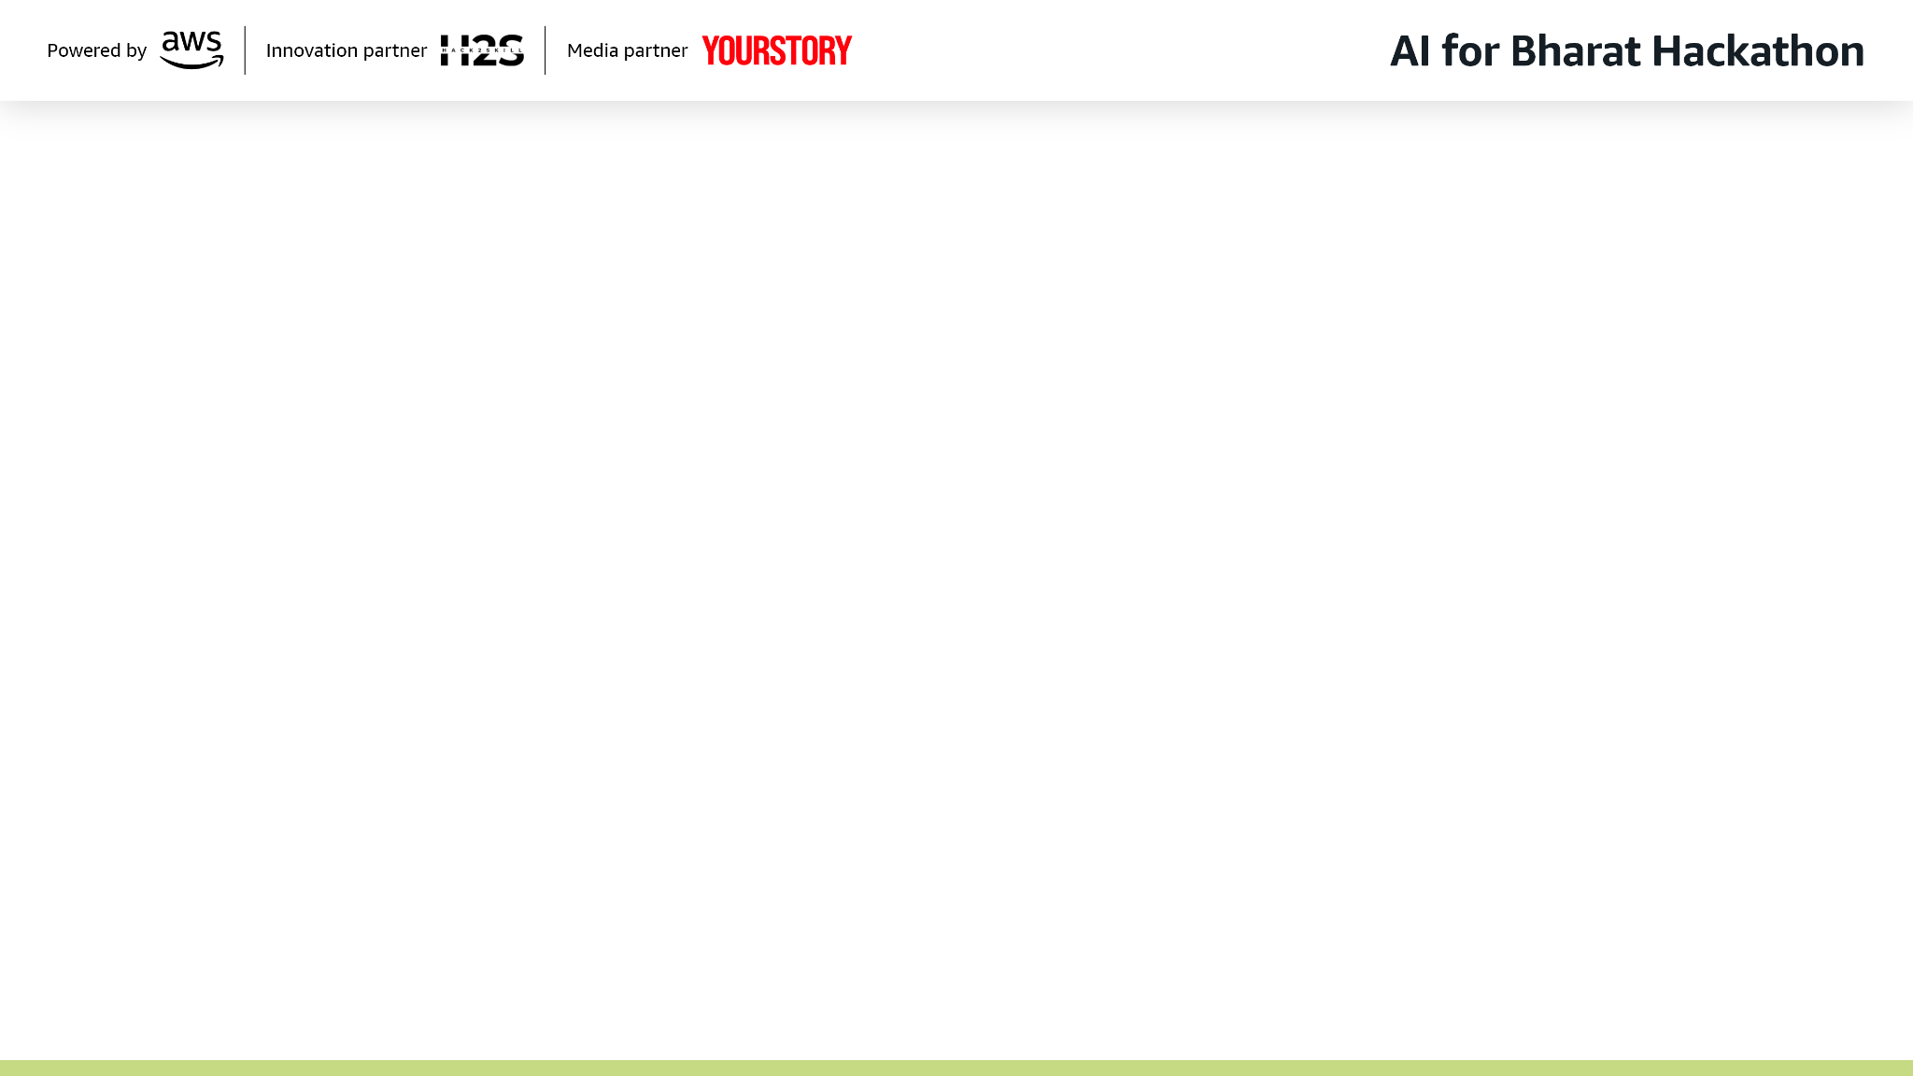
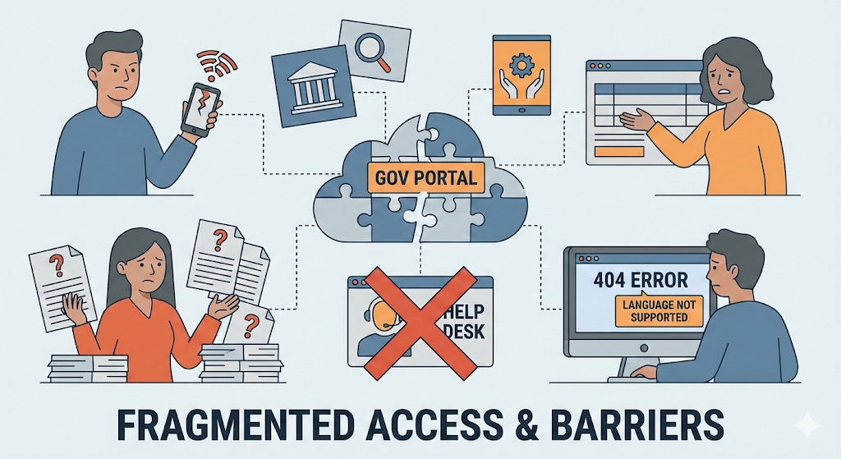
Brief about the Idea:
Problem Overview:
Citizens Struggles with
Fragmented government portals
Language & literacy barriers
Complex forms & procedures
No unified help system
Low-bandwidth connectivity
Result: Missed schemes, failed applications, poor public-service access.

Slide 3
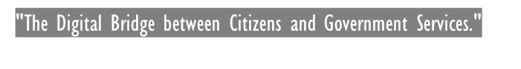
Brief about the Idea:
Proposed Solution- LokSathi AI:
LokSathi AI is a comprehensive multi-package platform designed to bridge the gap between citizens and government services through a unified, voice-first & text-query interface. The system addresses critical challenges in civic service access including fragmented portals, language barriers, complex procedures, and connectivity issues. Built for low-bandwidth environments and basic smartphones, LokSathi AI provides step-by-step explanations of eligibility, required documents, and application procedures. By reducing dependence on middlemen and focusing on inclusion, accessibility, and real-world usability, the app empowers communities to independently access public resources and participate more effectively in social and economic programs.​

Slide 4
How is LokSathi AI Different from Existing Solutions? ​
Existing platforms are full of text, complicated, and limited to certain languages.​
Most solutions need a reliable internet connection and some digital skills.​
LokSathi AI prioritizes voice and local languages.​
It is tailored for low-bandwidth situations and basic smartphones.​
It emphasizes guidance and understanding rather than just providing information.
The platform employs a microservices architecture with six specialized packages: Civic Assistant, Document Center, Community Zone, Farmer & Rural, Education, and Admin & Government.
​Each package provides domain-specific functionality while sharing common infrastructure for voice processing, language translation, and portal integration.

Slide 5
How will it be able to solve the problem?
Users interact using voice & text in their native language.
AI understands user intent and retrieves accurate civic information.​
Provides step-by-step guidance for schemes and public services.​
Reduces dependency on middlemen and offline agents.​
Enables easy access to government benefits and opportunities​.
Guided access to the government schemes and document services.

Slide 6
USP of the LokSathi AI
Voice-first & text-based interaction with multi-linguistic support
Low-bandwidth optimization for rural connectivity
Secure integration with government portals
Real-time guidance and assistance
Scalable microservices architecture
- Comprehensive analytics and reporting

Slide 7
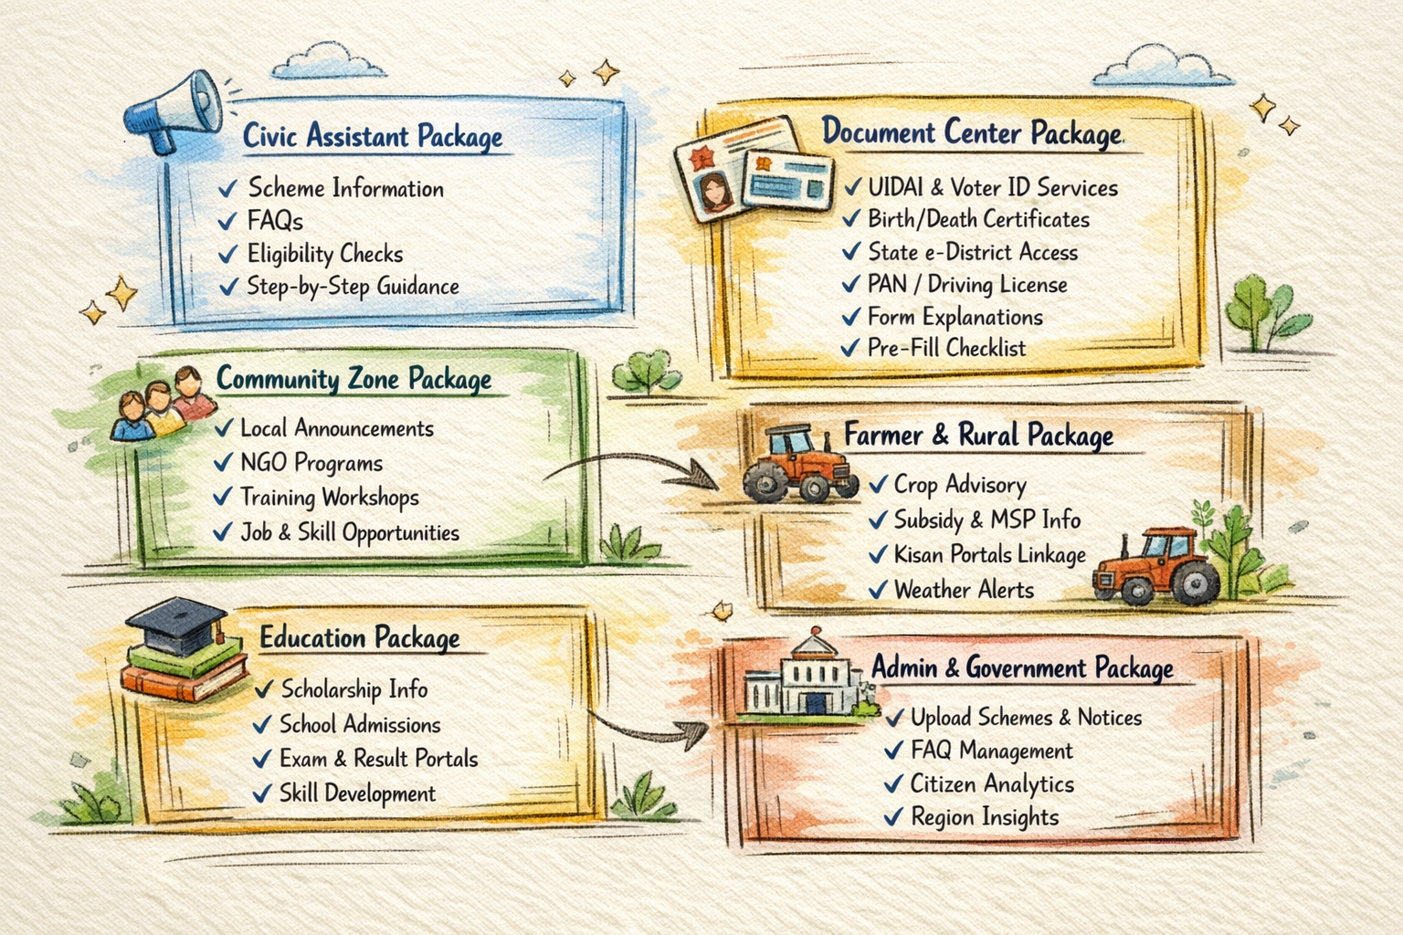
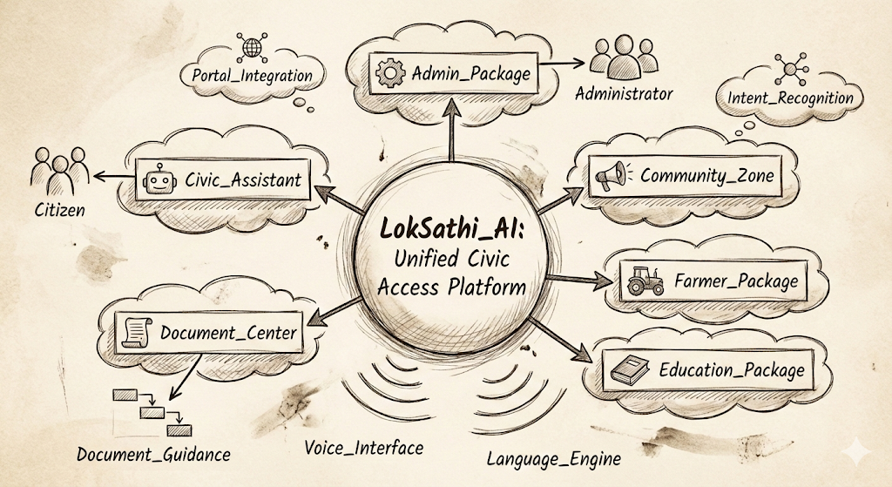
List of features offered by the LokSathi AI

Slide 8
Detailed List of features offered by the LokSathi AI
-Civic Assistant: The AI-powered guidance module for scheme information and eligibility
-Document Center: The module providing guided access to government document services
-Community Zone: The module for local announcements and community programs
-Farmer Package: The specialized module for agricultural services and information
-Education Package: The module for educational services and scholarship information
-Admin_Package: The administrative interface for government officials
-Voice Interface: The speech recognition and synthesis system
-Chatbot: Users can ask query and know about schemes and eligibility using Voice and text-based chatbot.
-Portal Integration: The system connecting to external government portals
-Language Engine: The multi-linguistic processing and translation system
-Citizen: Any user accessing government services through the platform
-Administrator: Government officials managing content and analytics
-Intent Recognition: The AI system that understands user requests
-Document Guidance: The system providing step-by-step document application help

Slide 9

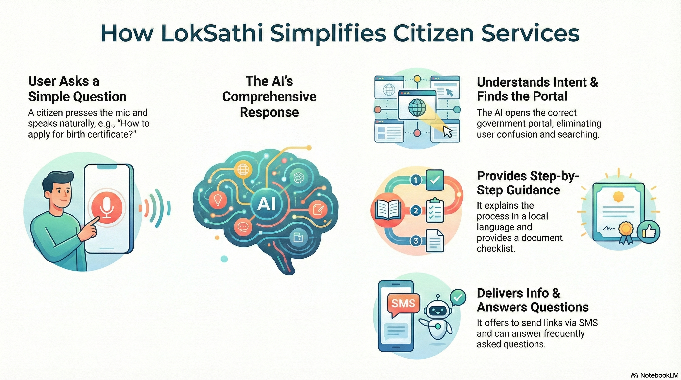

Slide 10
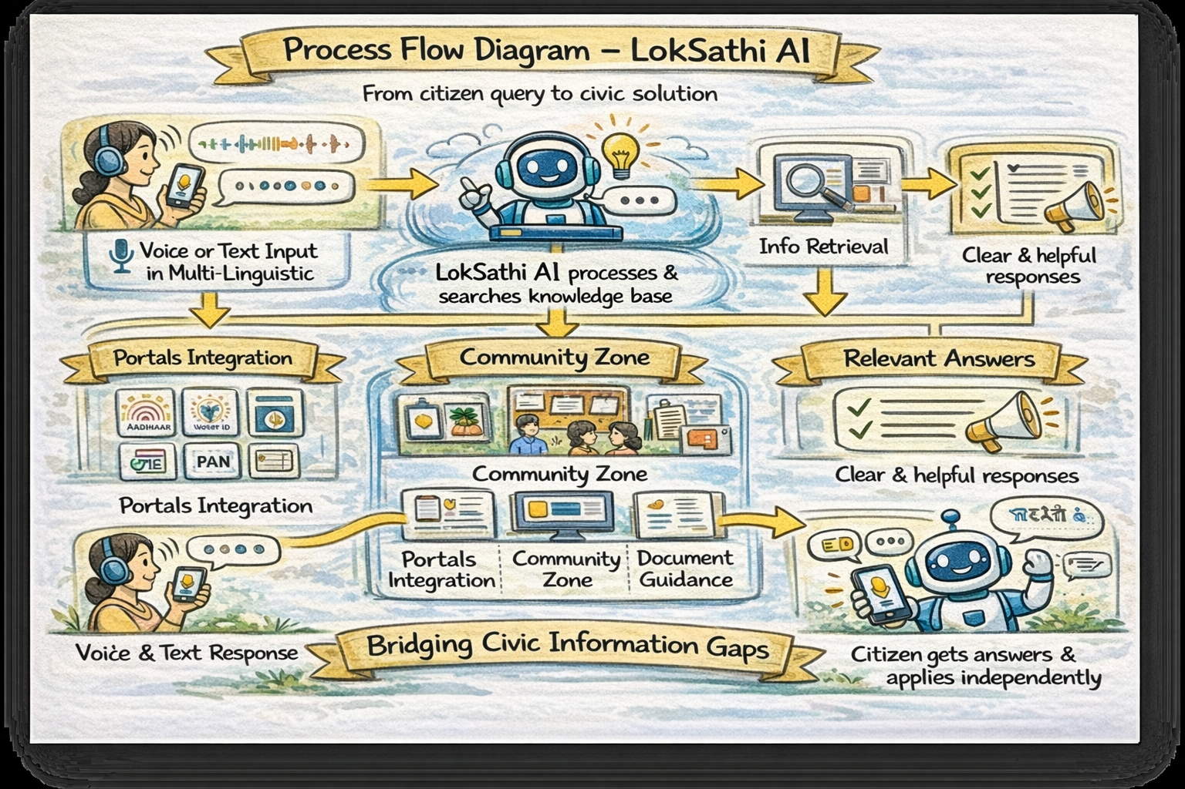
Process flow diagram:​
[ User Opens LokSathi AI ]​
​
[ Voice / Text Query in Local Language ]​
​
[ Speech-to-Text Conversion ]​
​
[ AI Intent Understanding ]​
​
[ Scheme / Service Information Retrieval ]​
​
[ Step-by-Step Guidance Generated ]​
​
[ Voice + Text Response ]​
​
[ User Understands & Applies Independently ]​
​

Slide 11
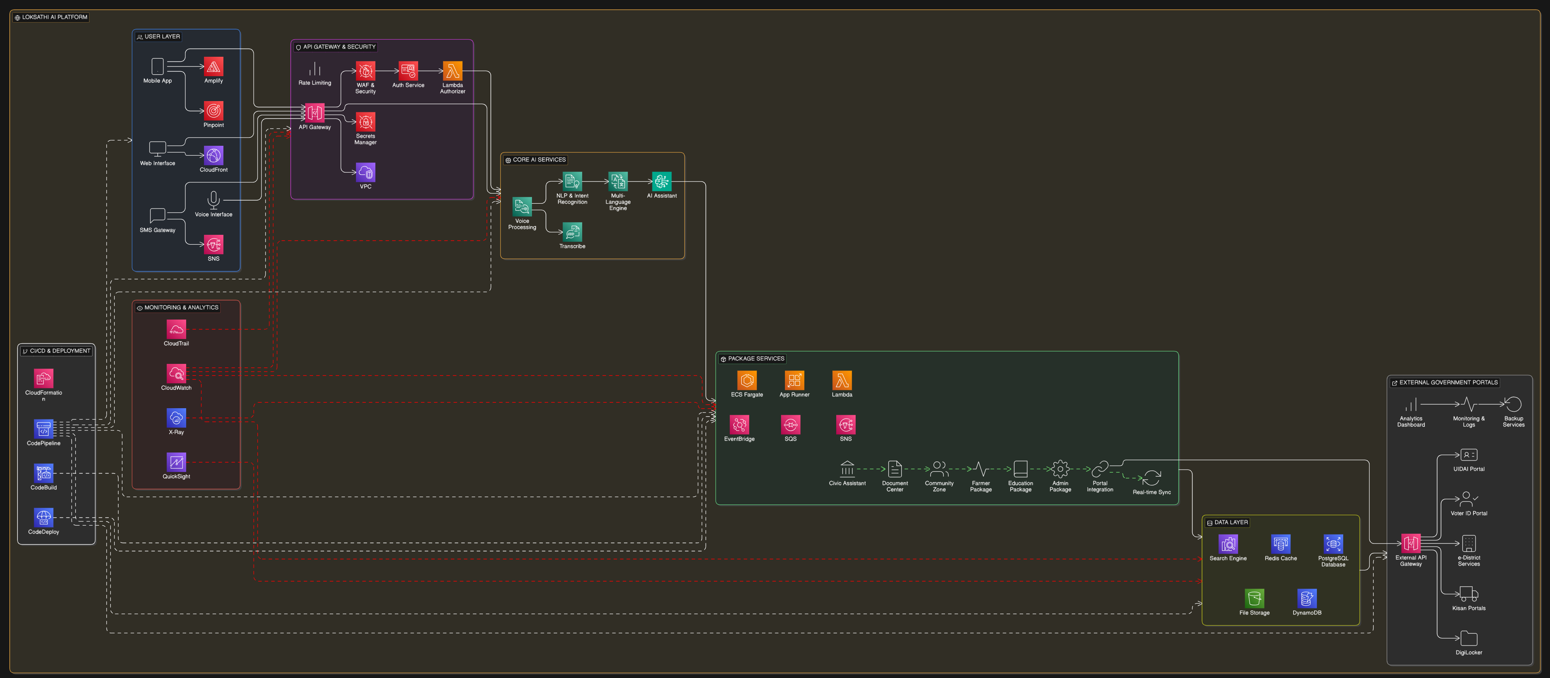
Architecture diagram of the proposed solution:
…

Slide 12
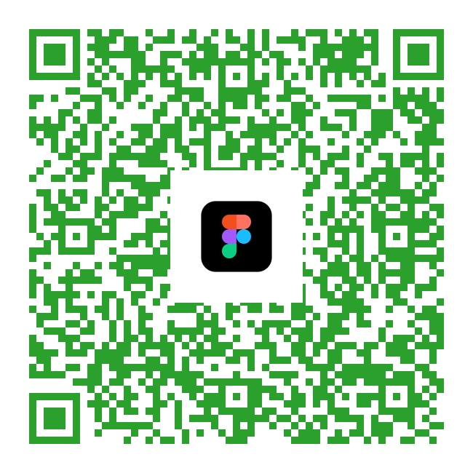
Wireframes of the LokSathi AI
Scan it for Wireframe.
Figma Wireframe for LokSathi AI

Slide 13

Technologies to be used in the solution:
💻 Technology Stack
Frontend
Backend
FastAPI (Python)
REST APIs
Simple OTP auth
Next.js PWA
Tailwind CSS
Web Speech API (mic access)
Service Workers (offline mode)
Hosting
Docker
Render / Railway / AWS EC2
Cloudflare CDN
Google Cloud
AI Layer
Whisper (Speech-to-Text)
Indic-TTS / AI4Bharat TTS
Multilingual LLM (Llama / Gemma)
RAG with FAISS vector store
Database
PostgreSQL (schemes, FAQs, portals)
JSON-based seed data

Slide 14
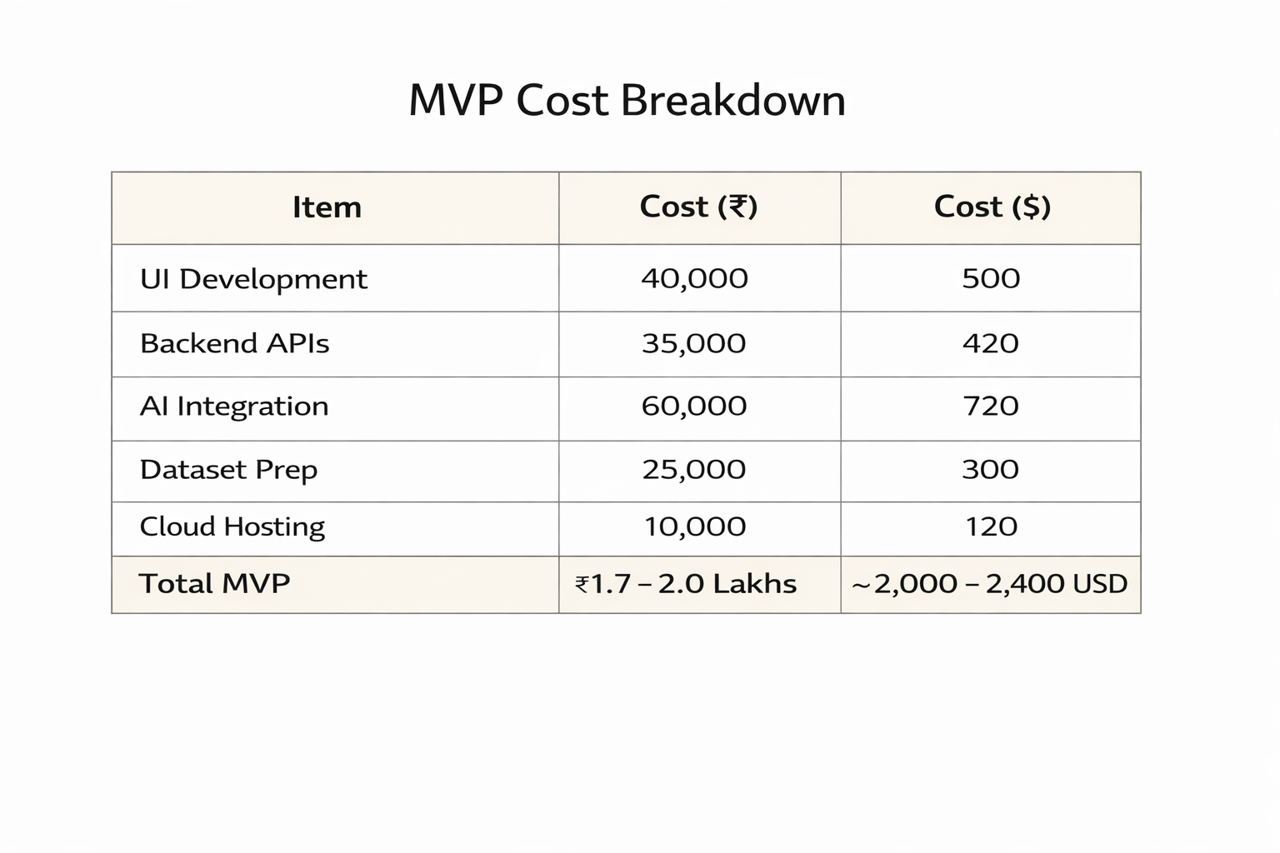
Estimated implementation cost:

Slide 15
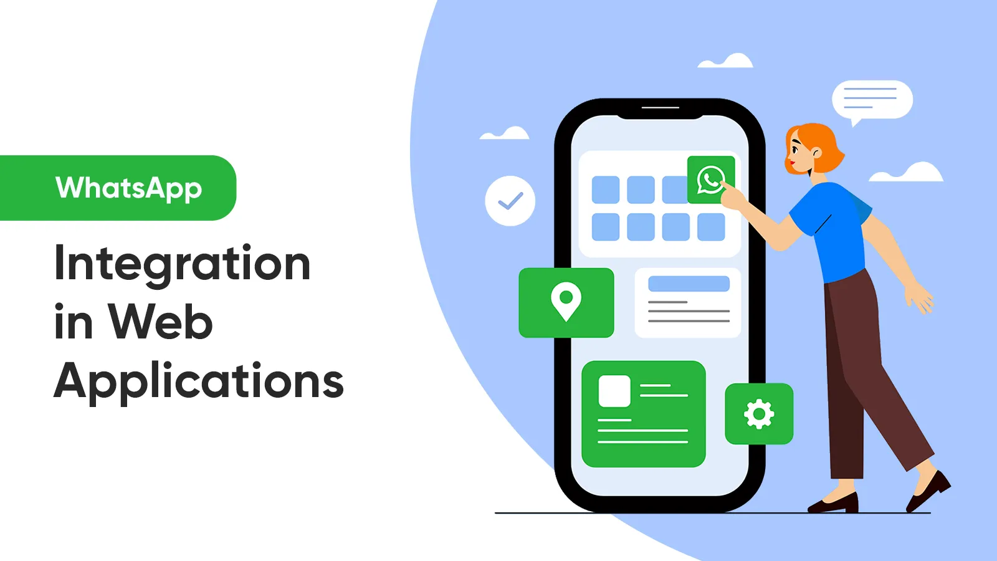
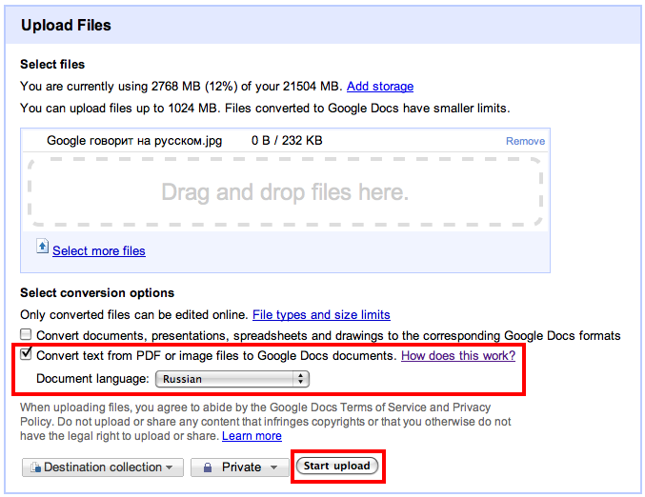
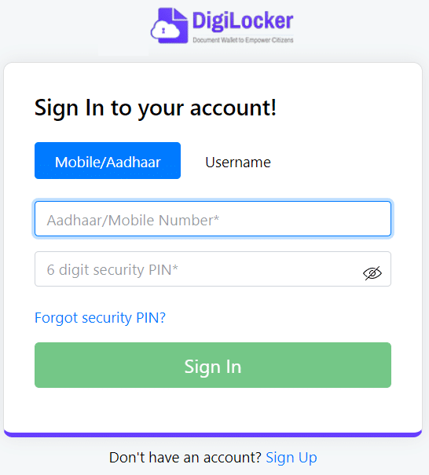
Upcoming agenda
Single Sign-On with Digi Locker
OCR for document upload
Auto form filling
WhatsApp integration
Regional kiosks

Slide 16
